Slide 1

收集单模板
Golden Idea Collection(金点子收集单)
Golden Idea Name(金点子名称）:
Abcam(Hangzhou) | Department: （部门） | Name: （姓名） | Proposed Date： （提交日期）
Problem Statement （发现的问题或需求）
Solution （改进方法或解决方法）
Are you willing to lead this improvement? （是否愿意参与这个改进?） | Yes or No

Slide 2

Background（问题背景）
Facing problem（面对的问题）
Proposed idea（好的点子）

Slide 3

Analysis and tests（分析和测试）
Describe the experiment test you have done or your improved plan
（描述做的测试或者准备改善的方案）

Slide 4
Result（结果）
Show the results(need figures, table and something else that you feel you need to show ?)
分享测试或改善后的结果（需要图、表或者其他你觉得需要展示的方面）

Slide 5
Conclusion（结论）
Describe what improvements you made, what the results are, and what are the benefits and risks?
（描述下你做了什么改善，成果是什么，带来的收益和风险是什么）
Benefit
Risk
EHS
Cost
FTE
EHS
Cost
FTE

Slide 6
Appendix – Cost saving calculation
Demand within this FY since implementation:
Hard saving:
Pre improvement:
Post improvement:
Soft saving/cost avoidance:
Pre improvement:
Post improvement:
Summary:
Material cost saving:
FTE cost saving:

Slide 7
(Project Name)
Team members：
Problem Statement 问题
Solutions 方法和措施
Performance 结果展示
Impact 现状对公司的影响
Benefits, Risks and Lessons 优点、风险 和 缺憾

Slide 8
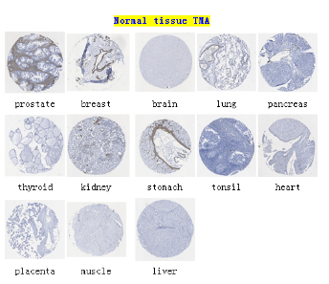
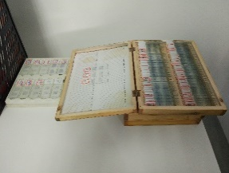
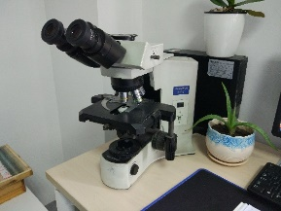
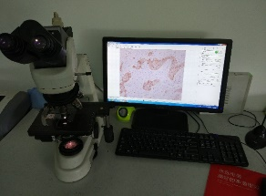
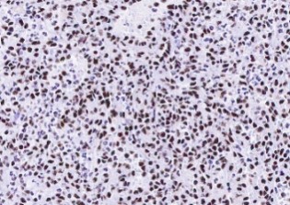
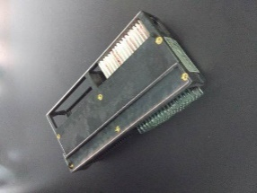
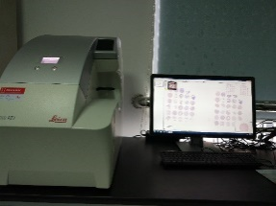
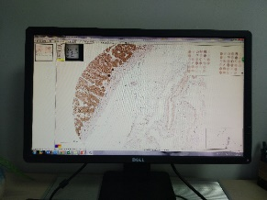
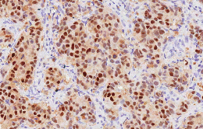
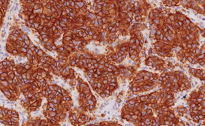
（参考）Scanner scope used for IHC image
Team members: Hongyang Pan, Xinxia zhang, Lucheng Zheng, Zhiqiang Lu, Ruifang Li, Chuan Tong, Qiong Yang, Yongfu Gao, Simei Guo, Hongjiao Huangfu, Xiwu Fan, Junhai Hu.
Problem Statement 问题
Solution 方法和措施
Show time
Although testing in more than 100 kinds of tissues in QC phase, only 6-7 of the tissue images can be saved for each project.
IHC scientists need to check the slides for 4-6 hours per day, which is harmful for their eyesight.
Need to sort and save hundreds IHC slides per day.
Keep too many slides in office which is harmful for health as the mounting reagent contains xylene.
Before
Now
Impact 现状对公司的影响
Benefits and Lessons 优点 和 缺憾
Maximum to keep the slides for 6 months, easy to lose the IHC data of previous products.
Can’t achieve the global alignment, and difficult to share the IHC data with other sites.
Xylene is harmful for health.
Benefits
Improve image quality and achieve the global alignment.
Keep the valuable IHC data during the whole development phase.
Reduce the retest rate if customers and the PMS want to review the IHC data 6 months before.
Save the time of sorting and keeping IHC data, don’t need to re-read slides when capture images, and don’t need to cost time to find previous slides.
Be benefit to employee’s health avoid too much exposure under xylene.
Lessons
The scan failure rate is about 5-10%, some slides needs to be re-scanned.
Need large storage to keep the IHC images, and need to sort and delete data in time.

Slide 9

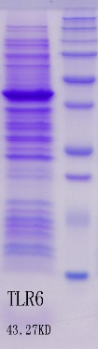

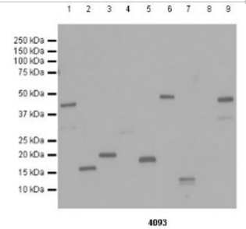
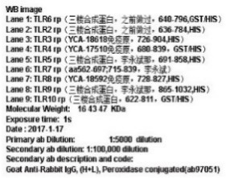
（参考） Recombinant Protein Production for Cross-reactivity test
of antibodies
Proposed by：Lichun Yao
Performed by: Lichun Yao, Mengli Zhan, Dan Li, Yanyan Zou, Bing Wang, Yuhan Luan
Problem Statement 问题
Solution 方法和措施
Show time
Before：
Some recombinant proteins are produced for the cross-reactivity test of antibodies or sera. In the past, we purified these proteins from cell lysates for the test, which usually takes 2-3 days and costs lots of work and resources.
有些重组蛋白的生产是为了检验抗体或血清的交叉反应情况。过去，对这些蛋白项目我们提供的是纯化的蛋白质，通常需要2-3周时间来生产，耗时耗力耗资源。
Plasmid transformation
Bacteria collection
Protein Purification
Protein quantitation and delivery
Overnight
Bacteria culture expression
200ml LB
Cell disruption
1 day
1 day
Protein refolding
Pick single colony
1 day
7hr
After：
Calculate bacterial cultures Vol for analysis
Protein expression validation and quantitation via SDS-PAGE
Plasmid transformation
Bacteria culture expression
Volume of bacterial cultures
=300/OD600
Protein delivery
Pick single colony
Overnight
5ml LB
7hr
Suspend bacteria pellet with 30ul loading buffer
Impact 现状对公司的影响
Benefits and Lessons 优点 和 缺憾
The production of these proteins occupied ¼ of RDG group’s workload and RDG group is very busy due to the heavy workload，which make some protein production cannot be completed on time.
这些检交叉项目蛋白的生产占据了RDG组1/4的工作量，而我们组的工作量又多有繁重，大大影响了工作效率,导致项目有时候不能及时完成。
Benefits
The new method can save 1-2 weeks for protein production for cross-reactivity test projects, and save 0.5 FTE as well.
检交叉项目周期至少缩短1-2周，节省了0.5个FTE
The new method does not need protein purification, which saves 900 RMB Yuan each project and save around 90000 RMB Yuan each year.
新方法省去了蛋白质纯化过程，所以每个项目可以节省900元，每年可节省90000元。

